Slide 1

Trivago Media Buying Case Study
Analyzing Efficiency of TV Ad Spots
Akshay Jain
Notes:
Good afternoon, everyone. Thank you for joining today’s session. I'll be diving into the Trivago media buying case study. My name is Akshay Jain, and I’ll begin with the presentation

Slide 2
Overview of the Case Study
Main objective
To understand how media buying decisions impact brand performance and identify potential areas for optimization.
Goal
Maximize cost-efficiency and enhance campaign success using quantitative analysis.
Notes:
The goal of the case study is to maximize the cost-efficiency of the media campaigns. This means not only reducing expenses but maximizing the returns on every Euro spent. Approach is to = Allocating a greater portion or a 10-second spots of our budget to prime time slots The Key Focus Areas of the case study are
Firstly , analyzing spending patterns to identify opportunities for financial optimization. Secondly, evaluating performance metrics to understand the effectiveness of different campaigns. And thirdly, looking at the ad formats to determine which works best with our target audience.
We can Use the quantitative data to develop a strategic approach to improve campaign effectiveness.

Slide 3
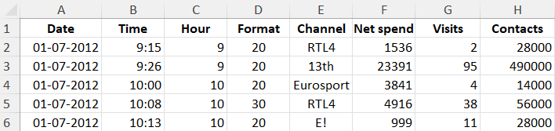
Overview of the Case Study
Dataset
Data includes details on advertising spots for different TV channels.
Essential for analyzing the cost-effectiveness and impact of different ad formats across various channels and time slots
Key tasks involved
Data Analysis
KPI formulation
Performance comparison.
Notes:
The data includes details on advertising spots for different TV channels.
Date: The date on which the ad aired.
Time: The specific time the ad aired.
Hour: The hour of the day during which the ad was broadcasted.
Format: The duration of the ad in seconds, that is 20-second and 30-second spots.
Channel: The TV channel on which the ad aired.
Net Spend: The cost of airing the ad on that channel at that time.
Visits: The number of visits or interactions resulting from the ad, suggesting a measure of the ad's effectiveness or reach.
Contacts: The estimated number of people who viewed the ad, representing the audience size for the ad slot.

Slide 4
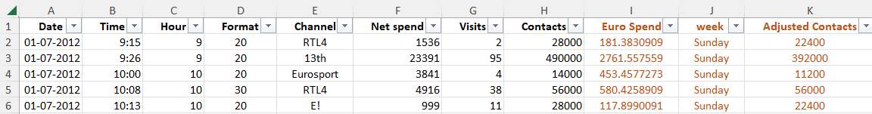
Initial Setup for Data Analysis
Currency conversion
Days of the week identification.
Adjusted contacts
Notes:
Convert net spend from NOK to € using conversion rate of 1 NOK = 0.11806€.
Identifying corresponding day of the week for each date. Excel function used : TEXT() Adjusted contacts – The spot length price index is defined in the case study. An 80% index was applied for 20" spots and 100% to 30" spots. This was done to normalize contact count because of the difference in ad durations. =IF(D2=20, H2*0.8, H2) Adjusting contact numbers based on ad spot length was done for comparison purposes.

Slide 5
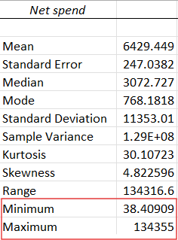
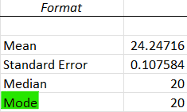
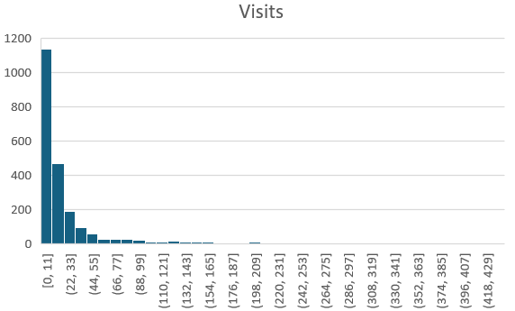
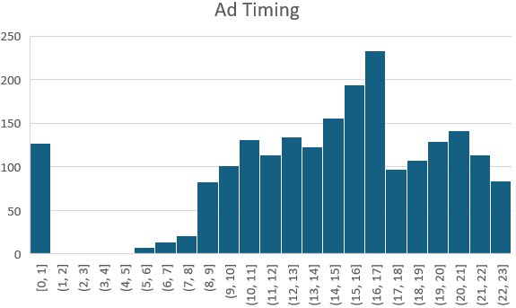
Descriptive Statistics Insights
High variance in spending
Data Skewness
Common Ad format
Ad timing
Notes:
High Variance in Spending: Large differences in spend. Some spots receive significantly more investment than others.
Skewed Data Distribution: Left-skewed distributions for net spend, visits, and contacts suggest a majority of low values, with few high outliers. Common Ad Format: 20" ads are the most frequent, showing preference for shorter spots. Ad Timing: Most ads are shown during mid to late afternoon slots., between 2PM to 5PM.

Slide 6
KPI Definitions
CPM (Cost Per Thousand Contacts)
CPM = (Net Euro Spend / Adjusted Contacts) * 1000
VPMC (Visits Per Million Contacts)
VPMC = (Visits / Adjusted Contacts) * 1000000
CPV (Cost Per Visit)
CPV = Net Euro Spend / Visits
Notes:
CPM (Cost Per Thousand Contacts): Measures the cost efficiency in reaching 1,000 viewers.
VPMC (Visits Per Million Contacts): It can be used to assess the engagement efficiency by calculating visits per million viewers.
CPV (Cost Per Visit): Evaluates the cost efficiency of generating a visit.
The purpose of these KPIs is to assess the cost-effectiveness and performance of each spot in terms of audience reach and engagement. It allows to compare the performance of different spots and channels.

Slide 7
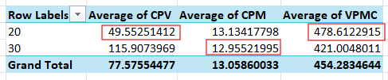
Comparative Analysis of Ad Spot Lengths
Cost Efficiency: 20" spots are more cost-effective.
Brand storytelling and recall: Lower CPM for 30“
Higher Engagement: 20" spots drive higher VPMC.
Notes:
Cost Efficiency: each visit is much cheaper with 20" spots, making them more cost-effective when it comes to driving direct interactions. 20" spots are more cost-effective in driving individual viewer actions or visits.
Lower CPM for 30": Lower CPM values are better as they indicate lower cost to reach a thousand viewers. Longer 30" spots have lower cost per thousand impressions (CPM). Here, 30" spots are slightly more cost-efficient than 20" spots. It is more efficient for brand awareness campaigns. 30" spots allow for better brand storytelling and recall.
Higher Engagement: Higher VPMC values are better as they indicate more visits per million viewers reached.. 20" spots drive higher VPMC. Here, 20" spots are more effective in generating visits compared to 30" spots. 20" spots more effective for action-oriented campaigns.
Conclusion: Use 20“ spots can be used for direct action and 30" for brand awareness and recognition.

Slide 8
Performance Analysis of weekdays & channels
High Activity on Monday - 'Ned1' and 'RTL4’
Cost Efficiency - 'Erediv' and 'Eurosport' have low costs for running ads over several days
Weekend Engagement - 'Animal' and 'Comedy' get more viewers on weekends.
Effective Spending on Eurosport
Notes:
High Activity on Monday: Channels like 'Ned1' and 'RTL4' have a lot of activity on Mondays, both in terms of visits and the amount of money spent on ads.
Cost Efficiency: Channels like 'Erediv' and 'Eurosport' have low costs for running ads over several days, making them cost-effective choices.
Weekend Engagement: Channels like 'Animal' and 'Comedy' get more viewers on weekends, probably because people have more free time to watch TV.
Effective Spending on 'Eurosport': 'Eurosport' is a good choice for ad spending because it maintains a good balance between cost and viewership throughout the week.

Slide 9
Recommendations for Campaign Modification
For Brand Awareness
Increase the allocation to 30" spots for lower CPM and better message recall.
Focus on high-viewership time slots to maximize reach.
Use 30" spots during prime time to capitalize on viewer numbers.
For Action-Oriented Campaigns
Prioritize 20" spots for better cost-efficiency in generating viewer engagement (high VPMC).
Use 20" ads in interactive programs or events with higher audience engagement.
Consider targeting sports events or key moments around high-action content.
Notes:
Lets look at the strategic modifications for the campaign to maximize reach and engagement.
We can use 30" spots for brand awareness. The use of 30" ads during high-viewership time slots would increase brand exposure and improve the chances of higher recall, even in the short term. This is particularly beneficial during prime time, where audience numbers are at their peak.
We can use 20" spots for driving viewer actions. Utilizing shorter 20" spots during high-action programming (like sports events or popular shows) can lead to an immediate increase in viewer actions, such as website visits or app downloads, due to the direct call to action often associated with these types of ads.
A mix of both ad lengths can be used depending on the campaign goal.

Slide 10
Impact of TV Campaigns
Short-Term Impact
Spike in Engagement
Real-Time Feedback
Tracking VPMC
Responsive Adjustments
Long-Term Impact
Brand Recognition
Customer Loyalty
Consistent Messaging
Notes:
Goal is to Drive immediate web traffic and boost user engagement.
Spike in Engagement: Shorter ad formats like 20" can drive immediate traffic and engagement spikes.
Real-Time Feedback: Increased visits immediately following specific campaigns indicate successful execution.
Tracking VPMC: Measuring visits per million contacts provides an actionable metric for evaluating short-term results.
Responsive Adjustments: Campaigns can be fine-tuned based on short-term data to maximize efficiency.
Brand Recognition: Continuous exposure to well-placed ads can lead to brand recall over time.
Customer Loyalty: Well-targeted campaigns build trust and long-term loyalty.
Consistent Messaging: Using 30" ads for consistent branding can contribute to sustained consumer interest.
Influencing Behavior: Long-term campaigns impact booking behavior by reinforcing brand associations.
KPIs for Long-Term: Cost per visit (CPV) and CPM can track the cost-effectiveness of long-term brand-building efforts.

Slide 11
Conclusion
Optimize Ad Allocation
Strategic Use of Time Slots
Monitor Performance
Short-Term vs. Long-Term Goals
Notes:
Optimize Ad Allocation: Use insights from KPIs to balance ad spend between 20" and 30" spots.
Strategic Use of Time Slots: Focus on high-viewership times for 30" spots and action-oriented content for 20" spots.
Monitor Performance: Track KPIs such as CPM, CPV, and VPMC to continuously assess campaign effectiveness.
Short-Term vs. Long-Term Goals: Tailor ad strategy to immediate engagement vs. long-term brand building.
Final Recommendation: Continuously analyze data, adjust campaigns in real-time, which help to boost performance.

